Slide 1
Logistic Regression

Slide 2
Logistic Regression (A Linear Regression Technique)
Classification Method
Statistical method for predicting binary classes
Outcome is always one of the two classes
Examples: 0/1, yes/no, T/F, etc.
Calculates the probability of event occurance
Example: Healthcare decisions
A special case of Linear Regression where target variable is catagorical in nature
Math &
Statistics
Machine Learning
DS
Software
Research
Domain
Knowledge

Slide 3
Logistic Regression Model Evaluation
Divide data into features (X1, X2, …) and target (Y)
Divide the data into train (X_train, y_train) and test datasets (X_test, y_test)
Math &
Statistics
Machine Learning
Original Dataset (5 Records)
X1 | X2 | X3 | X4 | Y
Training Dataset
(4 Records)
X1 | X2 | X3 | X4 | Y
DS
Research
Domain
Knowledge
X1 | X2 | X3 | X4 | Y
Testing Dataset (1 Record)
X_train, X_test, y_train, y_test = train_test_split(X, y, test_size=0.2)

Slide 4


Logistic Regression Workflow Find the best parameter that gives least error in predicting the output
Local Minima
Training Dataset
Global Min
Minimum Cost
Learning Algorithm
Cost
Input
Output
h(x)
h: cost function
Tangent Line
Parameter

Slide 5
Logistic Regression Algorithms
Quadratic (n=2) or higher order n>2 functions best represent the cost function
How many derivatives?
How do we get to the tangent line?
Newton Method
Libfgs
LibLinear
Computes 2nd derivatives
Stores all updates
Computationally Expensive
Memory intensive
Approximates 2nd derivative
Stores last few updates only and therefore, saves memory.
Superfast with small datasets
Library of large Linear Classifiers
Minimize multivariate function by solving iteratively
Start at a point, move towards minimum, one at a time.
Can’t run in parallel / multicore processors

Slide 6
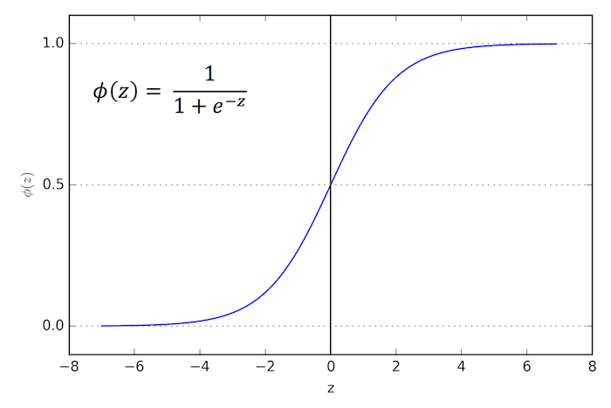
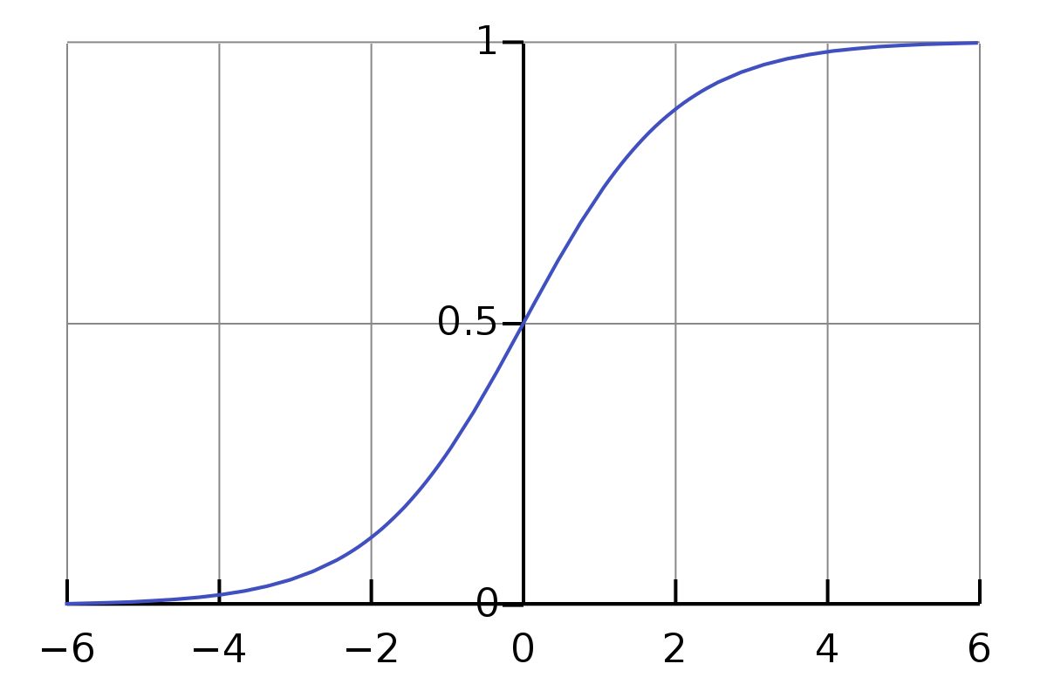
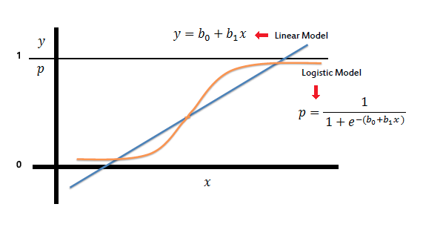
Logistic + Polynomial for Better Regression
Logistic function takes in any value and outputs is in the interval [0,1].
Sigmoid function Φ(x)
How to represent continuous data?
Overlay polynomials
HOW?
Math &
Statistics
Machine Learning
DS
Software
Research
Domain
Knowledge
What would be z = ? for a degree=3 polynomial?

Slide 7

Polynomial represents Logistic Regression
Substitute z = b₀ +b₁x into sigmoid function as ɸ(z).
Math &
Statistics
Machine Learning
DS
Software
Research
N=1
Domain
Knowledge
Logistic Model with
Polynomial of degree=1
$Φ\left(z\right)=$

Slide 8
Polynomial represents Logistic Regression
What would be z = ? for a degree=3 polynomial?
N=3
Math &
Statistics
Machine Learning
Polynomial of degree=3
b₀x³ + b₁x² + b₂x + b₃
DS
Software
Research

Slide 9
SkLearn-Logistic Regression
LogisticRegression(penalty='l2', *, dual=False, tol=0.0001, C=1.0, fit_intercept=True, intercept_scaling=1, class_weight=None, random_state=None, solver='lbfgs', max_iter=100, multi_class='auto', verbose=0, warm_start=False, n_jobs=None, l1_ratio=None)
Penalty. Increasing parameter weights versus over/underfitting
tol. Tolerance of the fit (stopping criteria for the model)
C. Inverse regularization strength. Smaller the value, larger is the penalty
fit_intercept. Bias
Solver. lbfgs, liblinear, and newton-CG
model = LogisticRegression(solver='liblinear', C=10.0, random_state=0).fit(x,y)

Slide 10
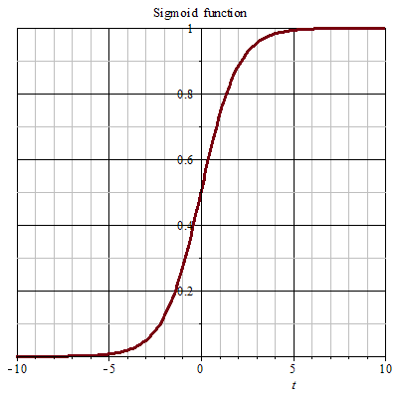
Linear Fit? For Logistic Regression
Machine Learning
DS
Software
Research
Degree = 1
Domain
Knowledge

Slide 11
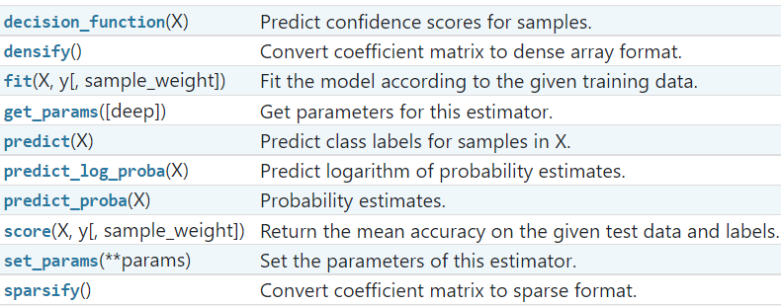
Methods available in Logistic Regression

Slide 12
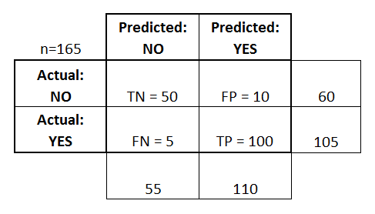
Confusion Matrix
Basic Terminology:
True Positives (TP). Cases in which predicted “yes” and actually “yes”
True Negatives (TN). Cases in which predicted “no” and actually “no”
False Positives (FP). Predicted “yes”, actually “no”: Type I error
False Negatives (FN). Predicted “no”, actually “yes”: Type II error
Reality
Machine Learning
Math &
Statistics
DS
Software
Research
Domain
Knowledge

Slide 13
Accuracy of the Model
Accuracy:
Overall, how often is it correct?
(TP + TN) / total = 150/165 = 0.91
Math &
Statistics
Machine Learning
Misclassification Rate (Error Rate):
Overall, how often is it wrong?
(FP + FN) / total = 15/165 = 0.09
DS
Software
Research
Domain
Knowledge

Slide 14
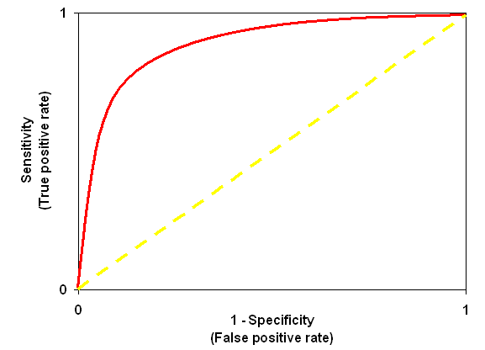
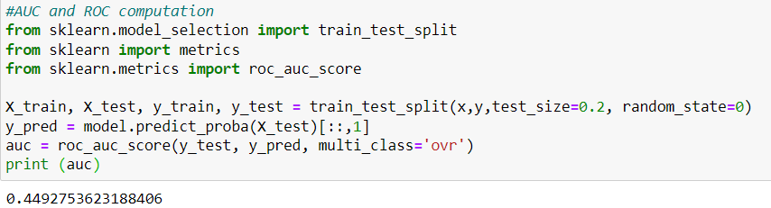
Metrics for Classification Models:
Area Under Curve (AUC). How well the model fits the data.
AUC (Area Under the Curve)
Math &
Statistics
DS
Software
Research
FPR: False Positive Rate
TPR: True Positive Rate
Domain
Knowledge

Slide 15
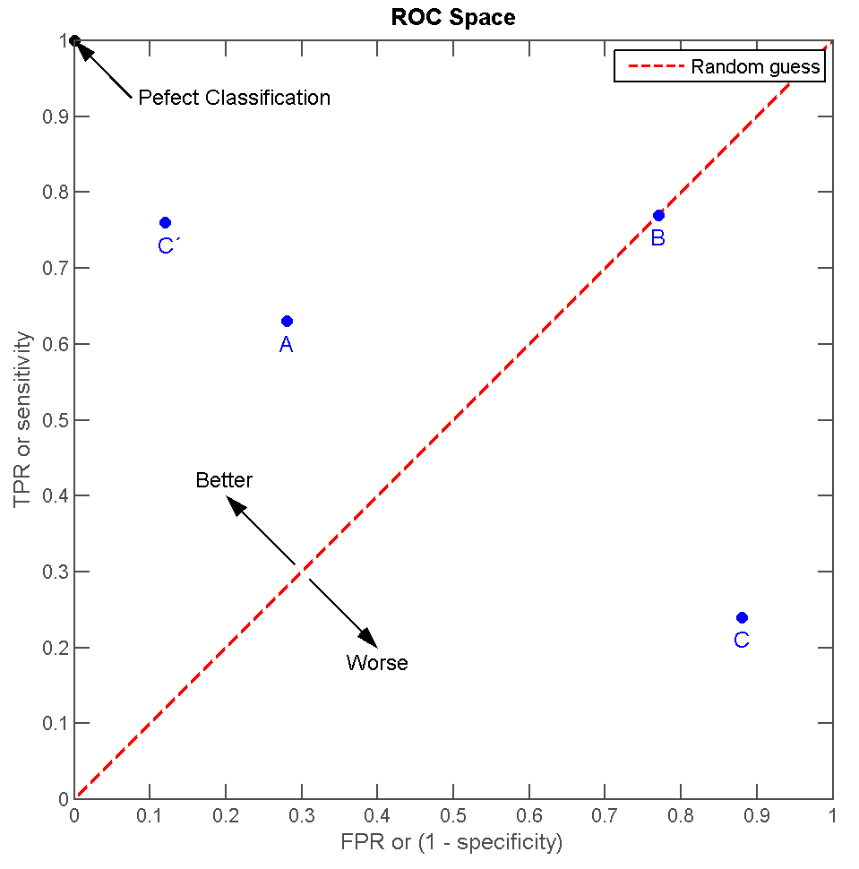
Receiver Operating Characteristic (ROC) curve
ROC is a plot of sensitivity vs FPR (1-specificity)
ROC is for tests which produce results on a numerical scale, rather than binary (+ vs - results)
Helps to generate decision threshold or cut off values, confidence intervals for sensitivity and specificity and likelihood ratios.
Pros:
The closer the apex of the curve toward the upper left corner, the greater discriminatory ability of the test
Simple method for determining optimal cut off values
Cons:
As the sample size decreases, the plot becomes more jagged
ROC calculation is cumbersome and needs specialized software
“Receiver Operating Space Characteristic 2 by Indon is licensed under the CC BY-SA 3.0 Unported. All other content herein is licensed and copyright under different terms and by different parties.”

Slide 16
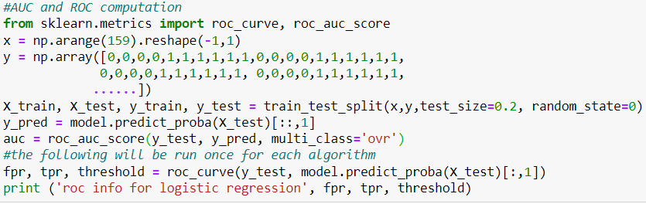
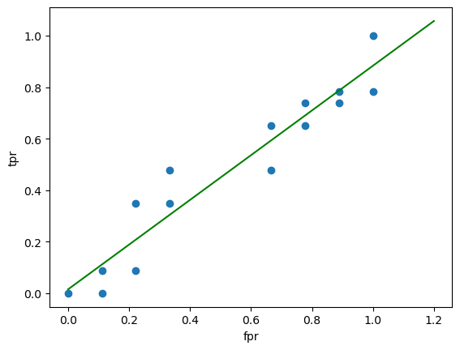
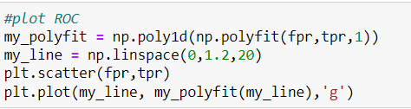
ROC for Logistic Reg on Binary Digits

Slide 17
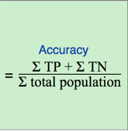
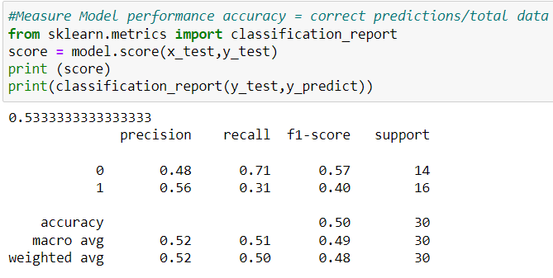
Accuracy and Classification Report
Score returns mean accuracy on the test data
Score = TP/Total Predictions
Precision = TP/(TP+FP)
Recall = TP / (TP+FN)
f1-score = 2*(Recall*Precision)/(Recall + Precision)
Precision: What percentage of your predictions are correct?
Recall: Percentage of positive cases you caught (#of positive cases correctly identified
f1-score: what percentage of positive predictions are correct
Support: # of actual occurrences of the class in the specified dataset

Slide 18
Key Terms
Accuracy Score. Measure the correct prediction of the classifier across the sample.
AUC-ROC curve. Visualize performance of the classification model based on its rate of correct/incorrect classifications. Key classifier of all models
Precision, Recall, and F1 score. Metrics from confusion matrix based on TRUE and FALSE classifications. (See Classification_Report)
Precision: What percentage of your predictions are correct
Recall: Percentage of positive cases you caught (#of positive cases correctly identified
f1-score: what percentage of positive predictions are correct
Support: # of actual occurrences of the class in the specified dataset

